Slide 1
My Ansible Project
Create Ansible playbook with roles to deploy python environments based on the amount of our requirements.txt files and install these requirements on our localhost.
Create ansible inventory & ansible config
Create roles
Create our playbook
Push our Ansible project to a fresh github repository.
Write CI/CD to deploy python environments & install requirements by triggering our Ansible playbook on every push or pull request to our main branch.

Slide 2
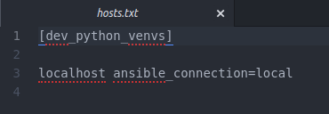
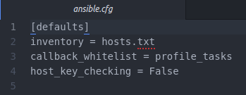
Ansible
To begin with, I would like to introduce my Ansible code and explain what it does. The first step was creating my inventory == hosts.txt file and ansible config.
I decided to create hosts file in txt format cause it’s clean and simple. Here I create the group dev_python_venvs and the host which is localhost with the connect type – local.
My ansible config consists of inventory path, callback whitelist that counts for us how much time was spent on every task and host key checking that allows us to bypath fingerprint for any new host.

Slide 3
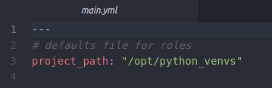
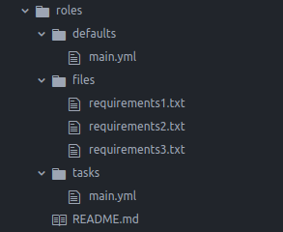
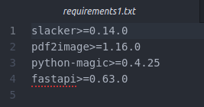
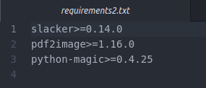
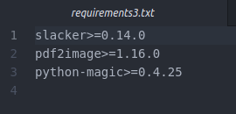
The next step was to create roles by using the command ansible-galaxy init roles
project_path variable to deploy my python venvs to

Slide 4
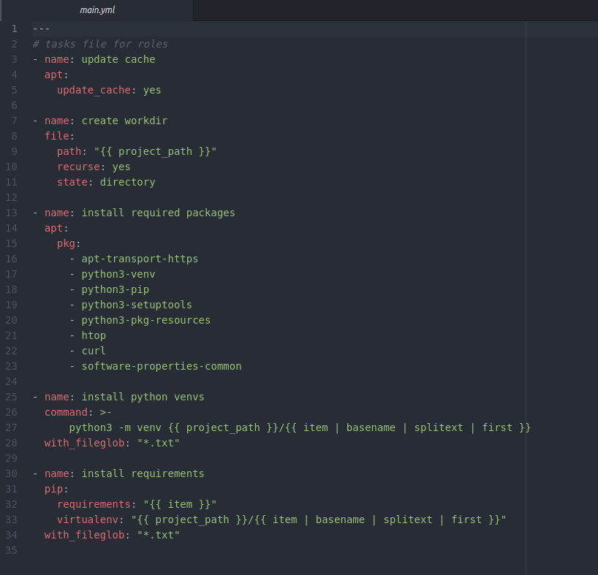
The last but not the least is my task main.yml file
The first task simply updates cache
The second task creates directory where our python venvs will be located
The third task pre-installs all necessary packages and some additional tools
The fourth task checks how many txt files we have in files folder and creates as many python venvs as the amount of txt files that are located there
The fifth task installs requirements for every python venv

Slide 5
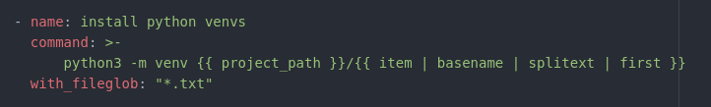
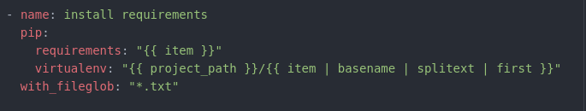
It’s better to sort it out that the fourth task uses command module to deploy our python virtual environments by using project_path variable and filters that help us to create these venvs.
with_fileglob: “*.txt” is a loop that checks our files folder to count all txt files and returns requirements1, requirements2, requirements3 result to our filter item and that’s how our venvs are created.
Let’s observe closely the fifth task that installs our requirements into python virtual environments. By using pip module we deploy our requirements, requirements argument collects all items that are returned from with_fileglob: “*.txt” loop and virtualenv argument points where our requirements should be installed.

Slide 6
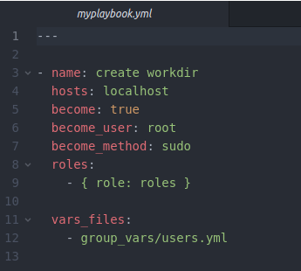
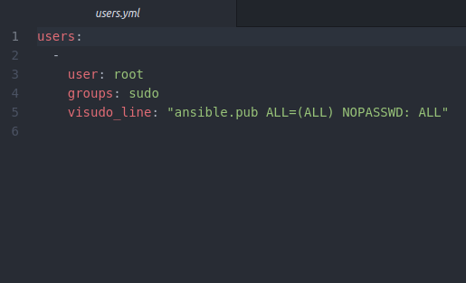
My Playbook
Should:
have a direct path to my roles
understand what is our host where we should deploy to
use group variables
switch to root user in order to deploy without any problems that are related to permissions
Here me specify:
The name of our play
Our host (localhost)
The next 3 commands give us root permission
We specify where our roles are located
We specify where our group variables are located
I should also mention my group variables file, which contains:
User group
We specify the user we are going tplaybooko use
visudo_line command prevents any password input so our ansible won’t fail

Slide 7
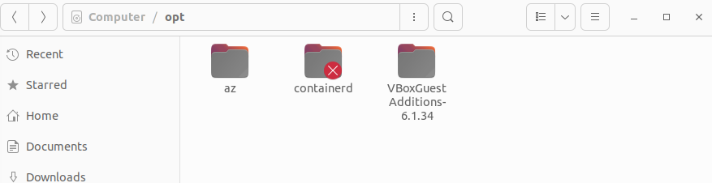
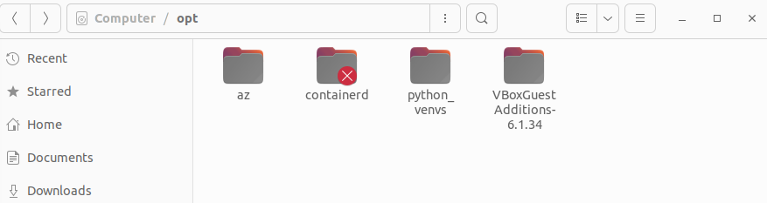
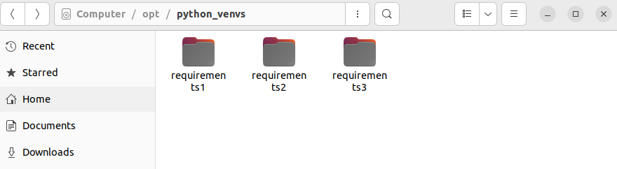
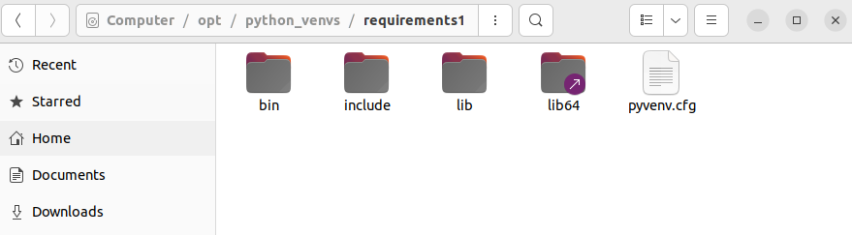
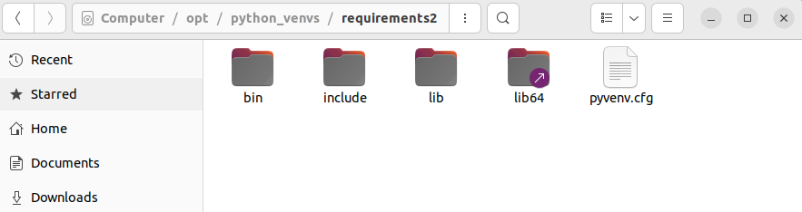
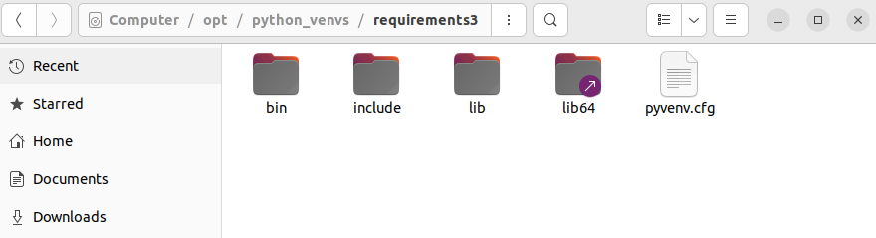
Test deployment on my machine
That’s what I have on my local machine before deployment
In terminal I went to the folder where my playbook is located and ran the next command:
ansible-playbook myplaybook.yml
Here we may see that it successfully created python_venvs folder
Inside python_venvs we may see our 3 python virtual environments. When we open them we can see that they are successfully deployed

Slide 8
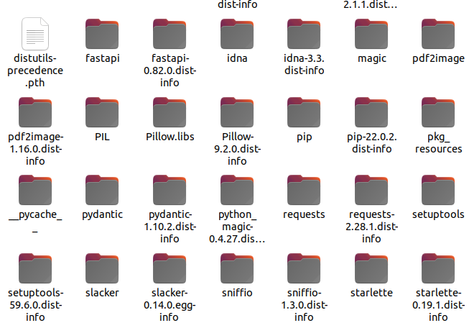
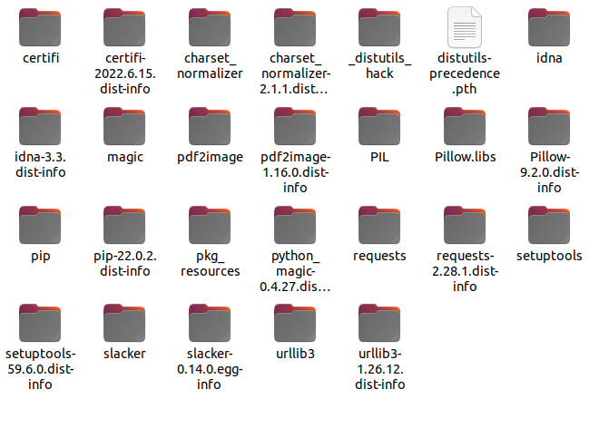
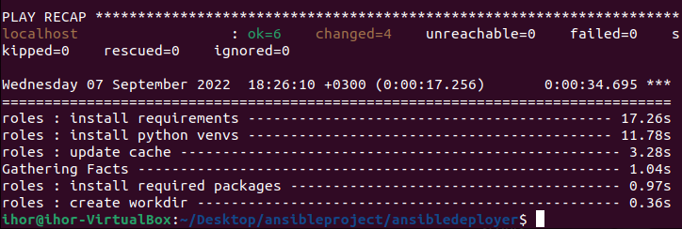
Final results
requirements1
If we compare requirements1 and requirements2 we may see that our libraries were installed successfully as well. Also, in requirements1 we can see fastapi library that wasn’t installed in requirements2 and requirements3 respectively (check slide 3).
Ansible Play Recap
requirements2

Slide 9
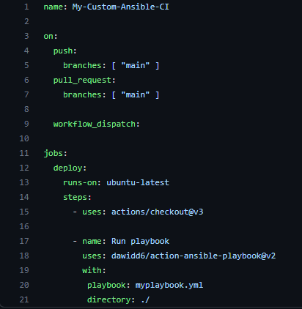
Github & Actions
As the code works just fine locally it was pushed to public github repository:
https://github.com/elkravchuk/pythonvenvdeployer
To automate our deployment I have created CI/CD in Action:
These blocks specify the trigger for our workflow, so our CI will be trigger on push or pull request to our main branch
Here we define the job which is called deploy, runner runs on ubuntu-latest and call out our steps that use actions/checkout@v3 version of actions
In the last block we run myplaybook.yml file and specify where it’s located in our repository

Slide 10
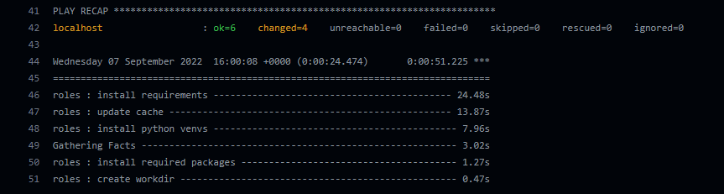
Conclusion
When I commit my changes to the new CI/CD it automatically starts and deploys python environments & installs requirements successfully
My Ansible project and CI/CD work as expected and deploys our job directly to Runner provided by Github without any problems.
Feel free to check my repository and my project
Thanks

